Slide 1
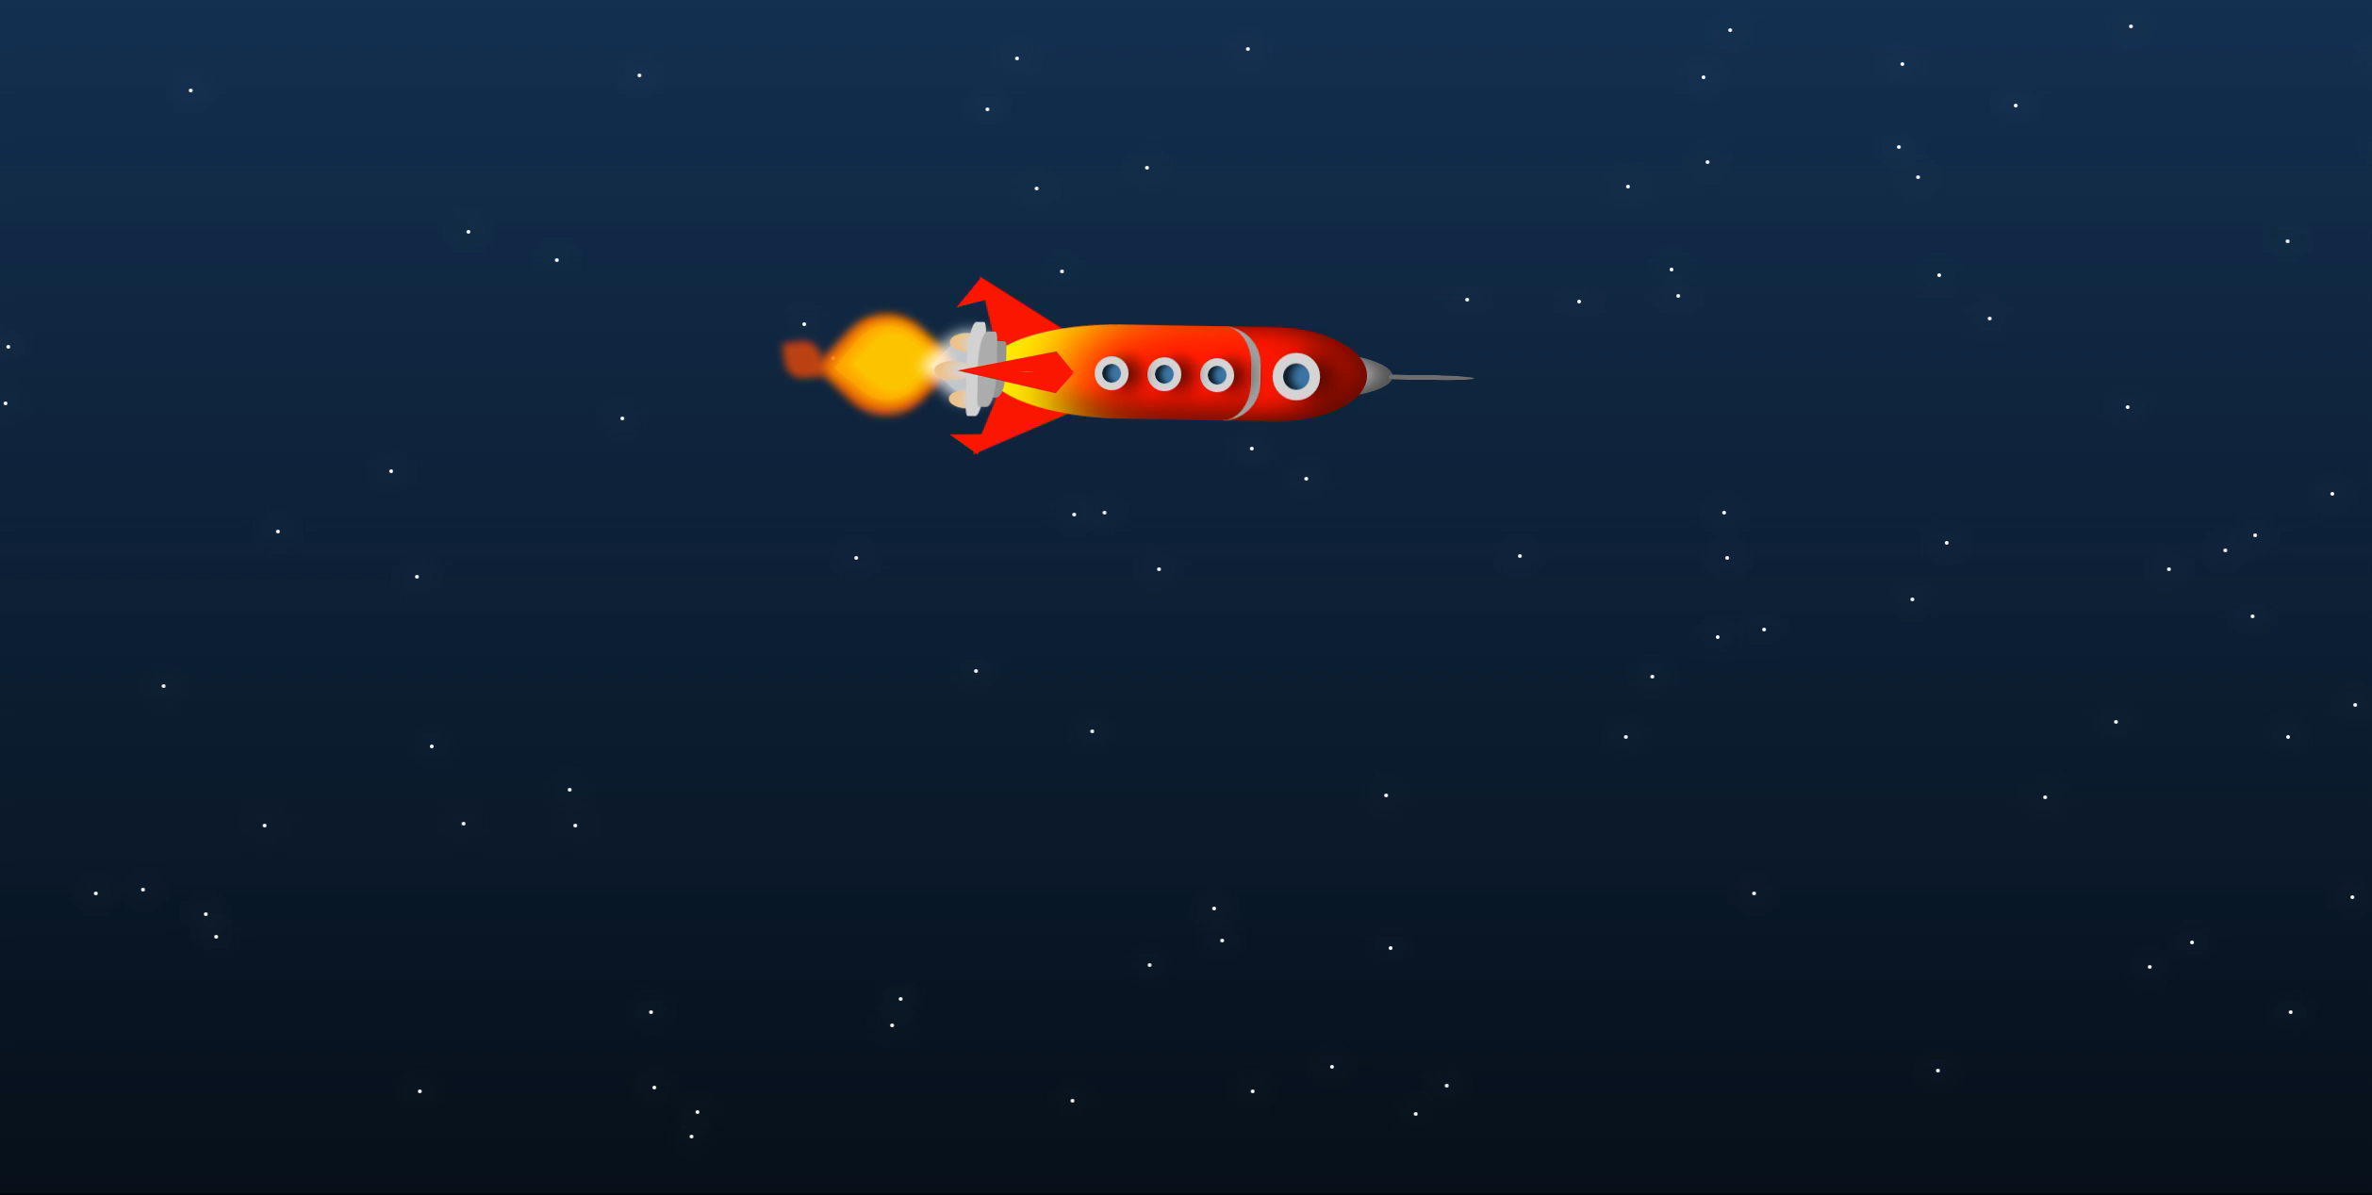



CRIANDO INTERFACES INTERATIVAS COM SVG + SASS + Js
Krystal Campioni
@krystalcampioni

Slide 2



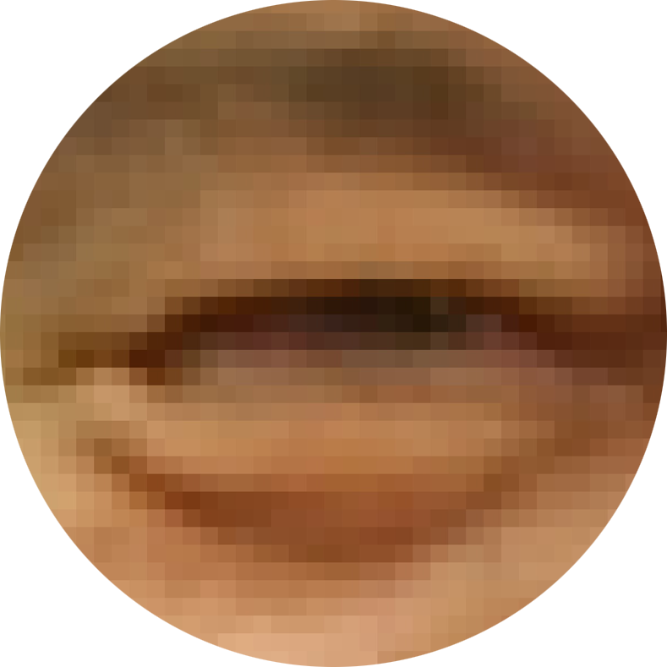
O que diabos é um SVG?
CRIANDO INTERFACES INTERATIVAS COM SVG + SASS + JAVASCRIPT
Scalable Vector Graphics ou Gráficos Vetoriais Escaláveis

Slide 3
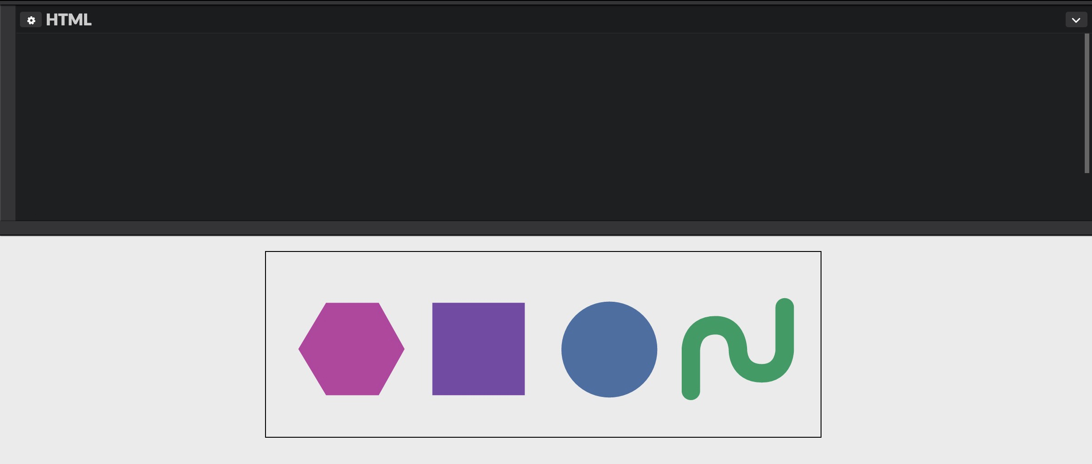
Legal, e como isso funciona?
CRIANDO INTERFACES INTERATIVAS COM SVG + SASS + JAVASCRIPT
1 2 3 4 5 6 7 8 9
<svg class="svg" xmlns="http://www.w3.org/2000/svg" viewBox="0 0 600 200"> <g id="group"> <polygon class="polygon" points="65,55 122,55 150,105 122,155 65,155 35,105"/> <rect class="rect" x="180" y="55" width="100" height="100"/> <circle class="circle" cx="371.5" cy="105.6" r="51.9"/> <path class="path" d="M459.7 150.3V106s-.3-26.7 26.7-26.7c24 0 24.2 26.7 24.2 26.7s-.7 25.3 25.9 ... 3V59.9"/> </g> </svg>

Slide 4
a tag SVg e o viewbox
CRIANDO INTERFACES INTERATIVAS COM SVG + SASS + JAVASCRIPT
1 2 3 4 5 6 7 8 9
<svg class="svg" xmlns="http://www.w3.org/2000/svg" viewBox="0 0 600 200"> <g id="group"> <polygon class="polygon" points="65,55 122,55 150,105 122,155 65,155 35,105"/> <rect class="rect" x="180" y="55" width="100" height="100"/> <circle class="circle" cx="371.5" cy="105.6" r="51.9"/> <path class="path" d="M459.7 150.3V106s-.3-26.7 26.7-26.7c24 0 24.2 26.7 24.2 26.7s-.7 25.3 25.9 ... 3V59.9"/> </g> </svg>
pop
x
y

Slide 5
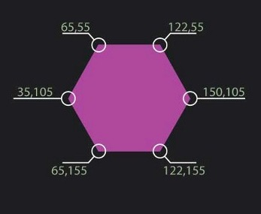
criando polígonos
CRIANDO INTERFACES INTERATIVAS COM SVG + SASS + JAVASCRIPT
1 2 3 4 5 6 7 8 9
<svg class="svg" xmlns="http://www.w3.org/2000/svg" viewBox="0 0 600 200"> <g id="group"> <polygon class="polygon" points="65,55 122,55 150,105 122,155 65,155 35,105"/> <rect class="rect" x="180" y="55" width="100" height="100"/> <circle class="circle" cx="371.5" cy="105.6" r="51.9"/> <path class="path" d="M459.7 150.3V106s-.3-26.7 26.7-26.7c24 0 24.2 26.7 24.2 26.7s-.7 25.3 25.9 ... 3V59.9"/> </g> </svg>

Slide 6
criando retângulos
CRIANDO INTERFACES INTERATIVAS COM SVG + SASS + JAVASCRIPT
1 2 3 4 5 6 7 8 9
<svg class="svg" xmlns="http://www.w3.org/2000/svg" viewBox="0 0 600 200"> <g id="group"> <polygon class="polygon" points="65,55 122,55 150,105 122,155 65,155 35,105"/> <rect class="rect" x="180" y="55" width="100" height="100"/> <circle class="circle" cx="371.5" cy="105.6" r="51.9"/> <path class="path" d="M459.7 150.3V106s-.3-26.7 26.7-26.7c24 0 24.2 26.7 24.2 26.7s-.7 25.3 25.9 ... 3V59.9"/> </g> </svg>
y
x

Slide 7
criando círculos
CRIANDO INTERFACES INTERATIVAS COM SVG + SASS + JAVASCRIPT
1 2 3 4 5 6 7 8 9
<svg class="svg" xmlns="http://www.w3.org/2000/svg" viewBox="0 0 600 200"> <g id="group"> <polygon class="polygon" points="65,55 122,55 150,105 122,155 65,155 35,105"/> <rect class="rect" x="180" y="55" width="100" height="100"/> <circle class="circle" cx="371.5" cy="105.6" r="51.9"/> <path class="path" d="M459.7 150.3V106s-.3-26.7 26.7-26.7c24 0 24.2 26.7 24.2 26.7s-.7 25.3 25.9 ... 3V59.9"/> </g> </svg>
y
x
r

Slide 8
criando paths
CRIANDO INTERFACES INTERATIVAS COM SVG + SASS + JAVASCRIPT
1 2 3 4 5 6 7 8 9
<svg class="svg" xmlns="http://www.w3.org/2000/svg" viewBox="0 0 600 200"> <g id="group"> <polygon class="polygon" points="65,55 122,55 150,105 122,155 65,155 35,105"/> <rect class="rect" x="180" y="55" width="100" height="100"/> <circle class="circle" cx="371.5" cy="105.6" r="51.9"/> <path class="path" d="M459.7 150.3V106s-.3-26.7 26.7-26.7c24 0 24.2 26.7 24.2 26.7s-.7 25.3 25.9 ... 3V59.9"/> </g> </svg>

Slide 9
Para desenhar paths facilmente:
CRIANDO INTERFACES INTERATIVAS COM SVG + SASS + JAVASCRIPT
Inkscape
Adobe Illustrator
Sketch App
para entender paths a fundo:
http://bit.ly/svgpath

Slide 10
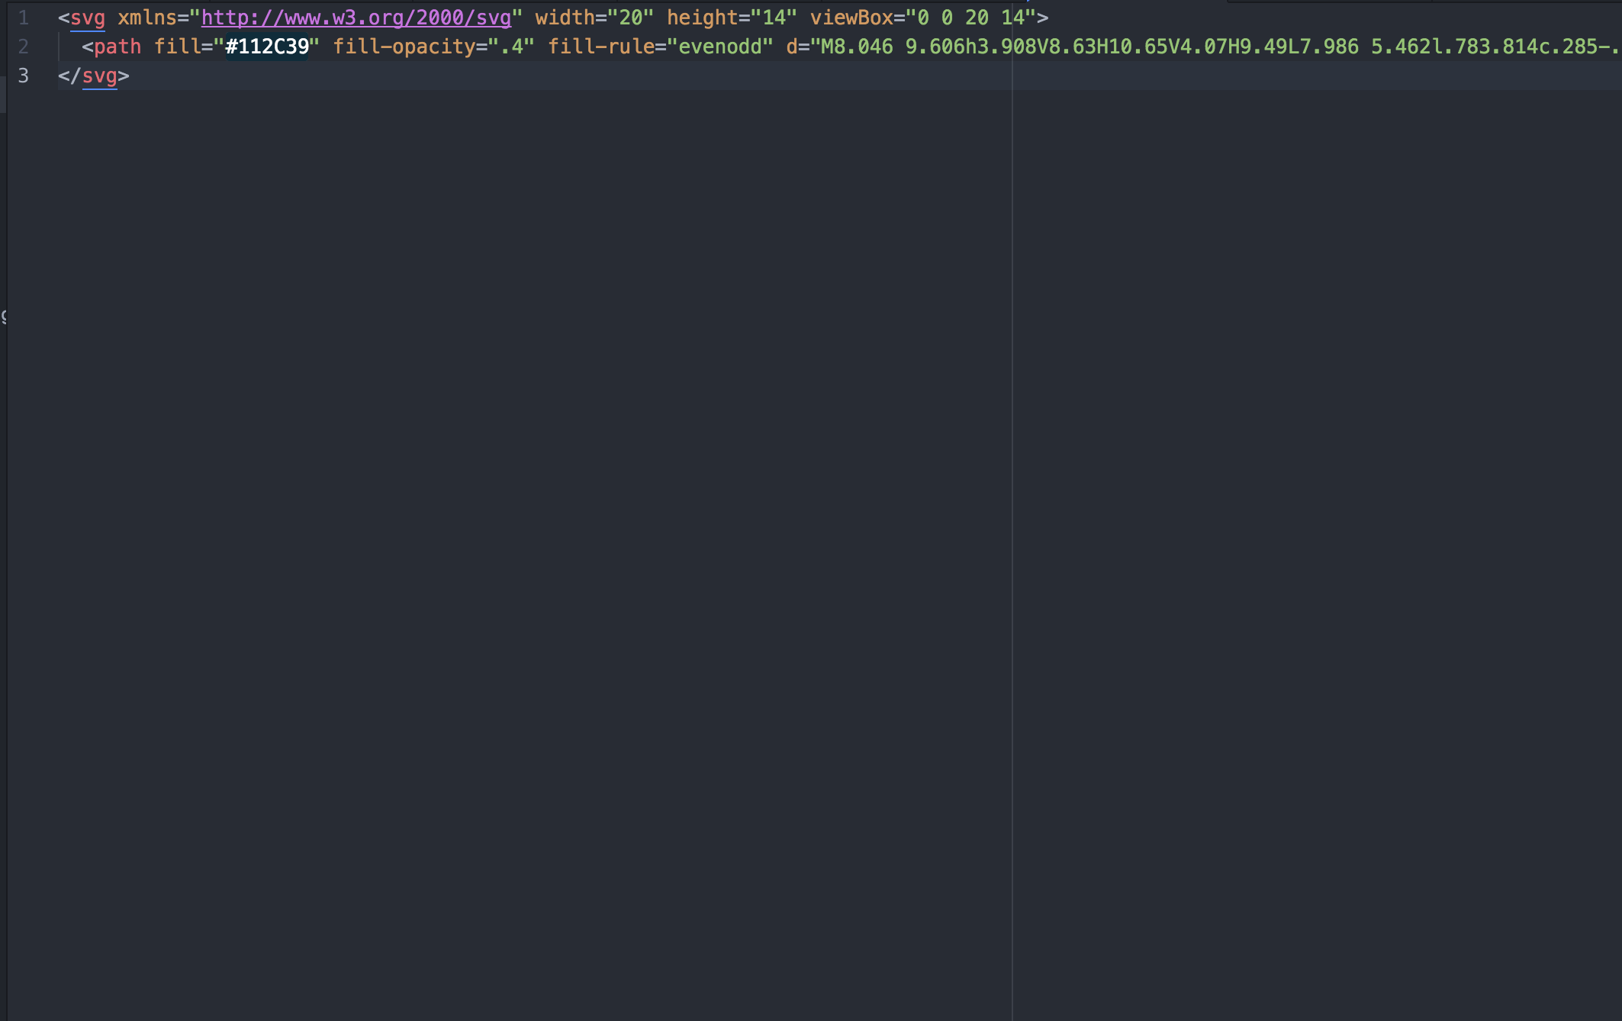
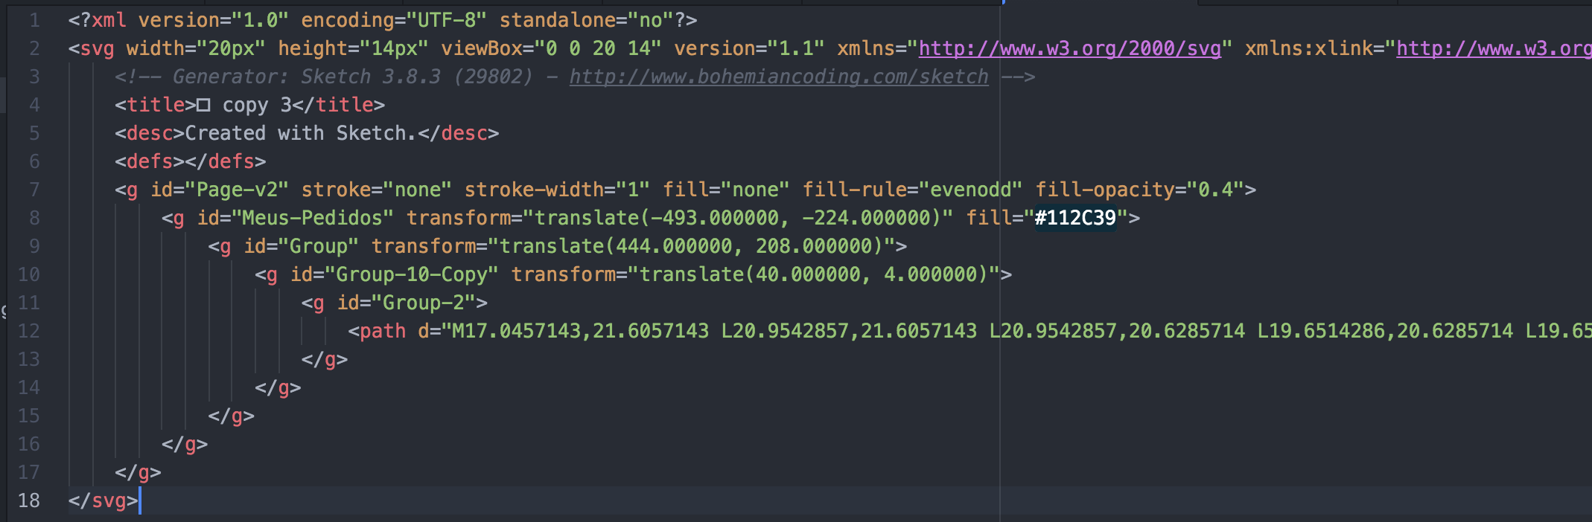
para otimizar svgs
CRIANDO INTERFACES INTERATIVAS COM SVG + SASS + JAVASCRIPT
SVGO
SVGOMG

Slide 11
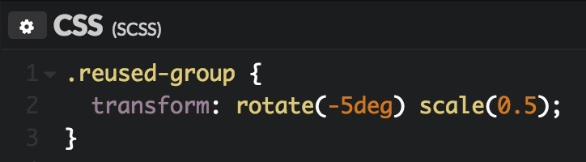
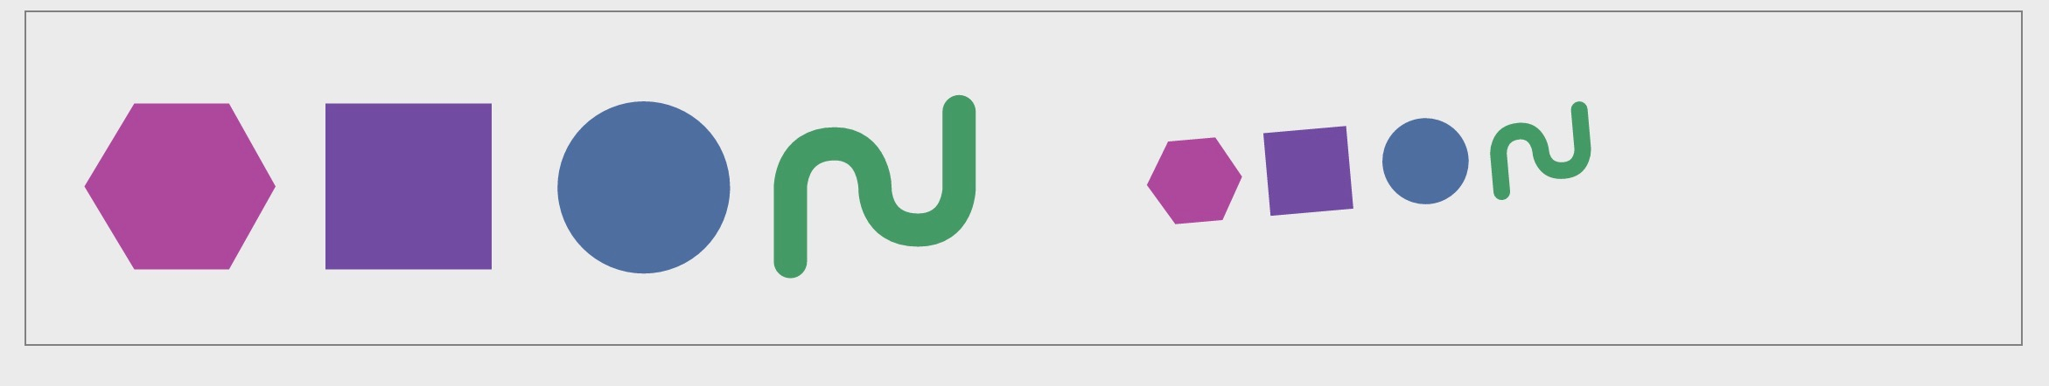
usando grupos
CRIANDO INTERFACES INTERATIVAS COM SVG + SASS + JAVASCRIPT
1 2 3 4 5 6 7 8 9
<svg class="svg" xmlns="http://www.w3.org/2000/svg" viewBox="0 0 600 200"> <g id="group"> <polygon class="polygon" points="65,55 122,55 150,105 122,155 65,155 35,105"/> <rect class="rect" x="180" y="55" width="100" height="100"/> <circle class="circle" cx="371.5" cy="105.6" r="51.9"/> <path class="path" d="M459.7 150.3V106s-.3-26.7 26.7-26.7c24 0 24.2 26.7 24.2 26.7s-.7 25.3 25.9 ... 3V59.9"/> </g> <use xlink:href=“#group" class=“reused-group" x="790" y="0"/> </svg>

Slide 12
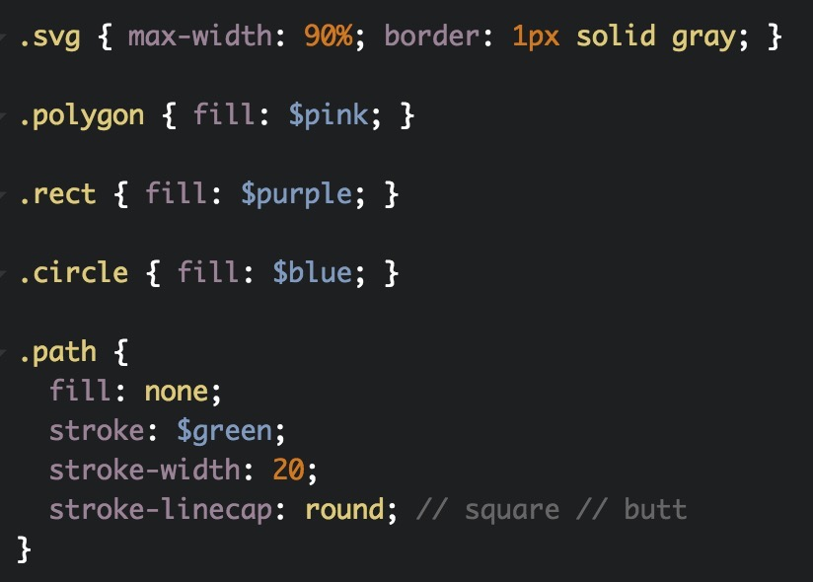
aplicando css em svgS
CRIANDO INTERFACES INTERATIVAS COM SVG + SASS + JAVASCRIPT
1 2 3 4 5 6 7 8 9
<svg class="svg" xmlns="http://www.w3.org/2000/svg" viewBox="0 0 600 200"> <g id="group"> <polygon class="polygon" points="65,55 122,55 150,105 122,155 65,155 35,105"/> <rect class="rect" x="180" y="55" width="100" height="100"/> <circle class="circle" cx="371.5" cy="105.6" r="51.9"/> <path class="path" d="M459.7 150.3V106s-.3-26.7 26.7-26.7c24 0 24.2 26.7 24.2 26.7s-.7 25.3 25.9 ... 3V59.9"/> </g> </svg>

Slide 13
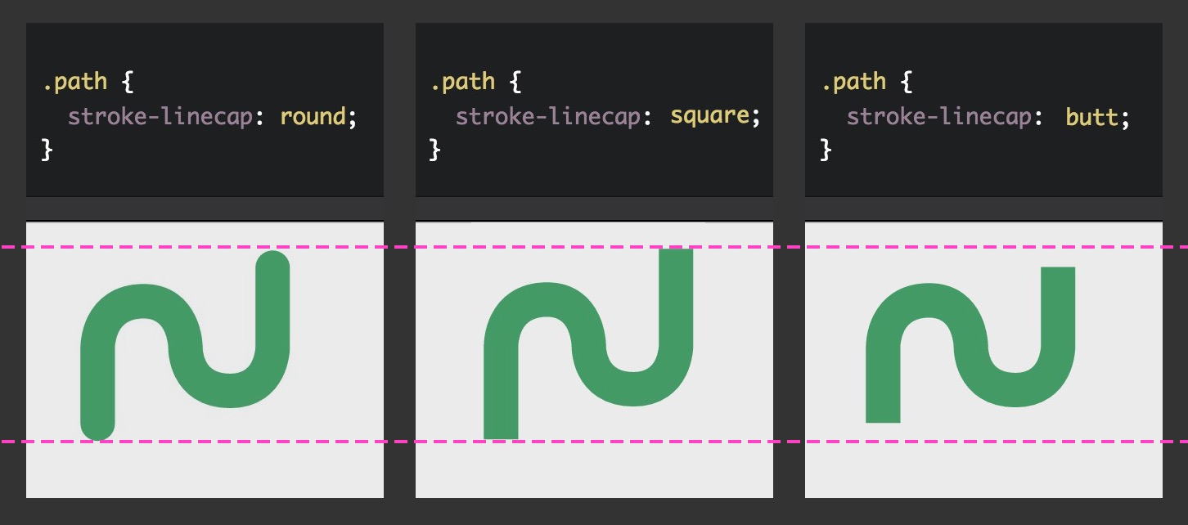
CRIANDO INTERFACES INTERATIVAS COM SVG + SASS + JAVASCRIPT

Slide 14
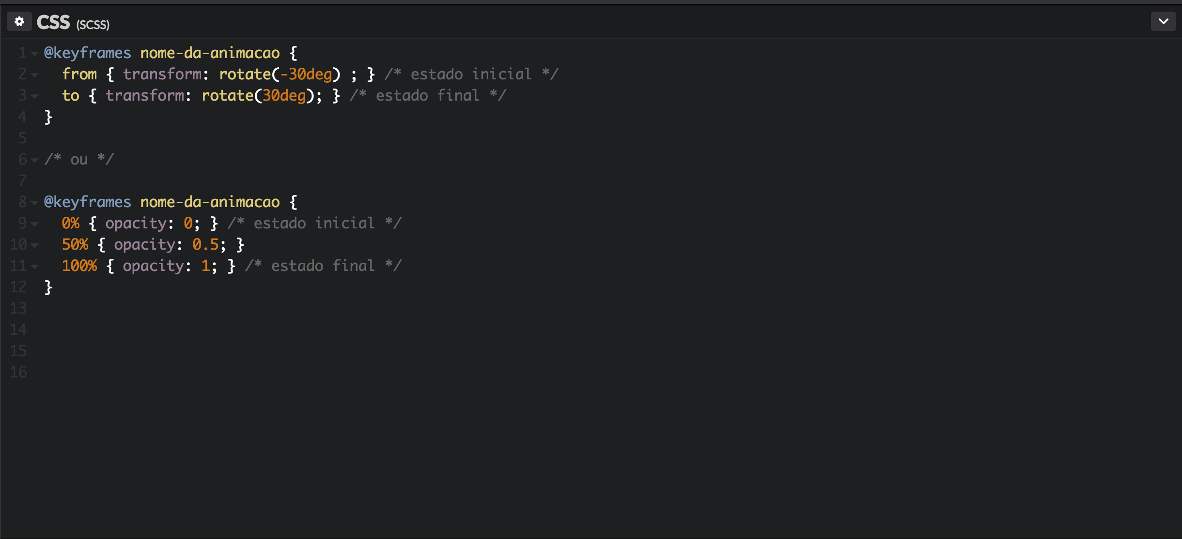
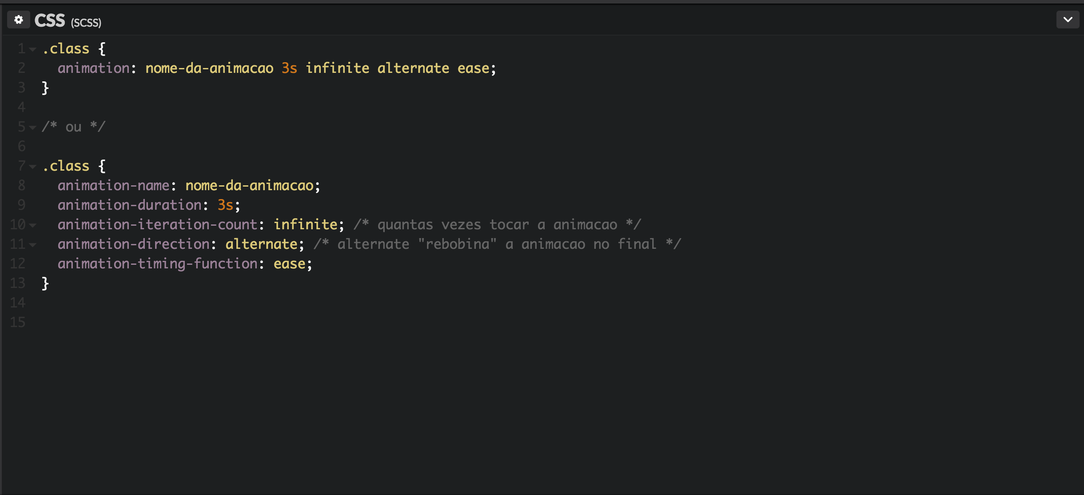
animações de keyframes em css
CRIANDO INTERFACES INTERATIVAS COM SVG + SASS + JAVASCRIPT

Slide 15
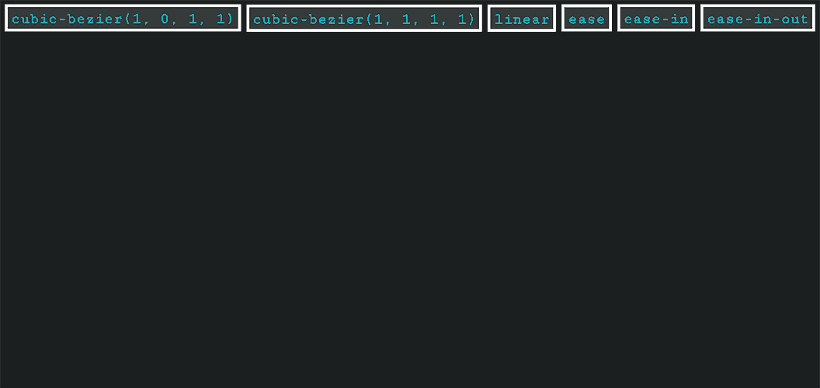
animation-timing-function
CRIANDO INTERFACES INTERATIVAS COM SVG + SASS + JAVASCRIPT

Slide 16
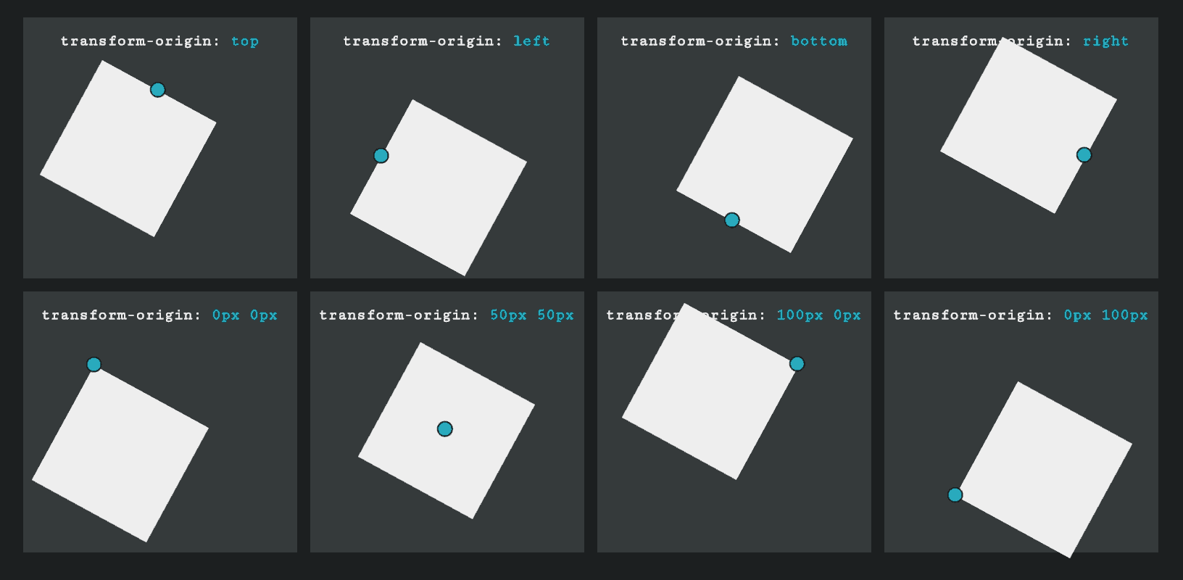
Transform-origin
CRIANDO INTERFACES INTERATIVAS COM SVG + SASS + JAVASCRIPT

Slide 17

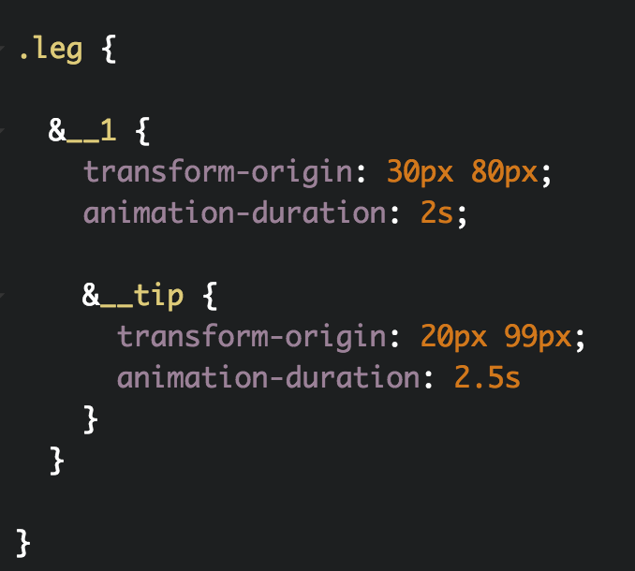
juntando tudo
CRIANDO INTERFACES INTERATIVAS COM SVG + SASS + JAVASCRIPT

Slide 18

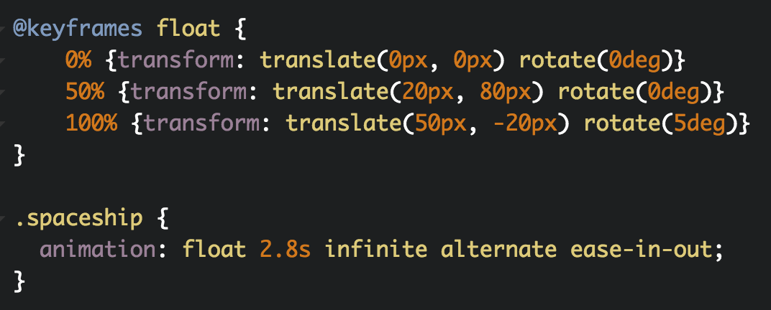
juntando tudo
CRIANDO INTERFACES INTERATIVAS COM SVG + SASS + JAVASCRIPT

Slide 19

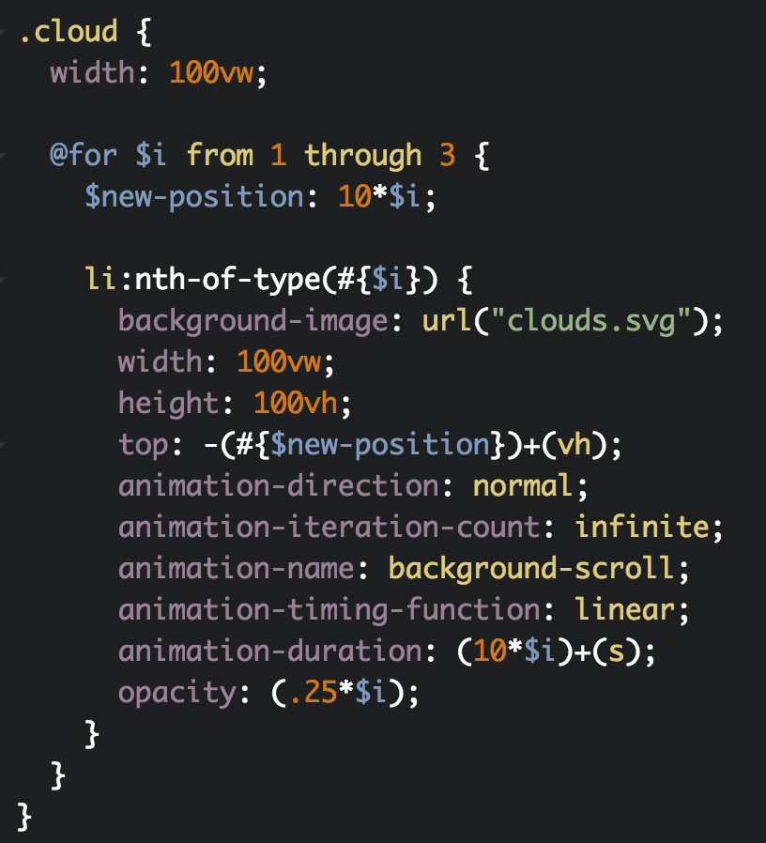
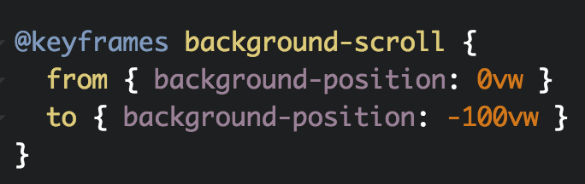
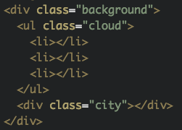
Backgrounds em SVG
CRIANDO INTERFACES INTERATIVAS COM SVG + SASS + JAVASCRIPT

Slide 20
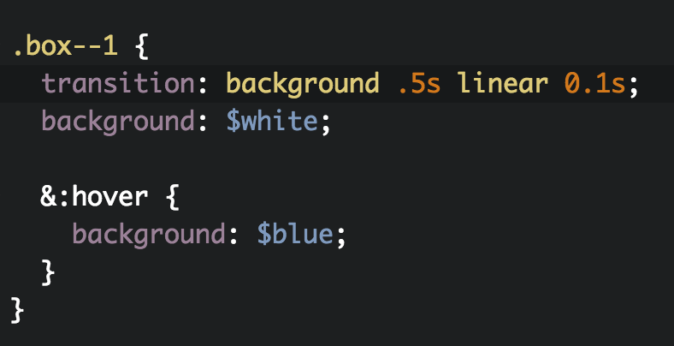

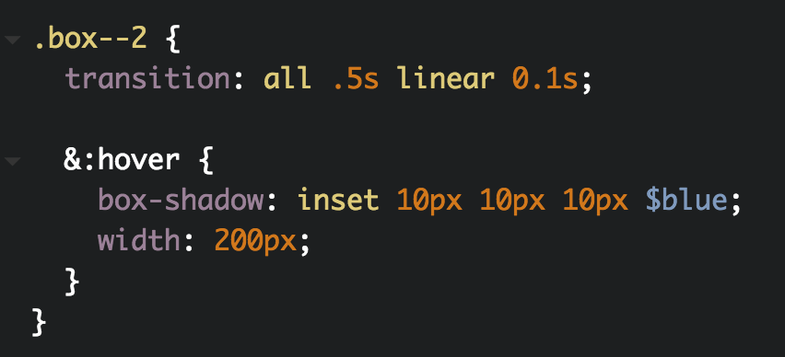
css transitions
CRIANDO INTERFACES INTERATIVAS COM SVG + SASS + JAVASCRIPT

Slide 21
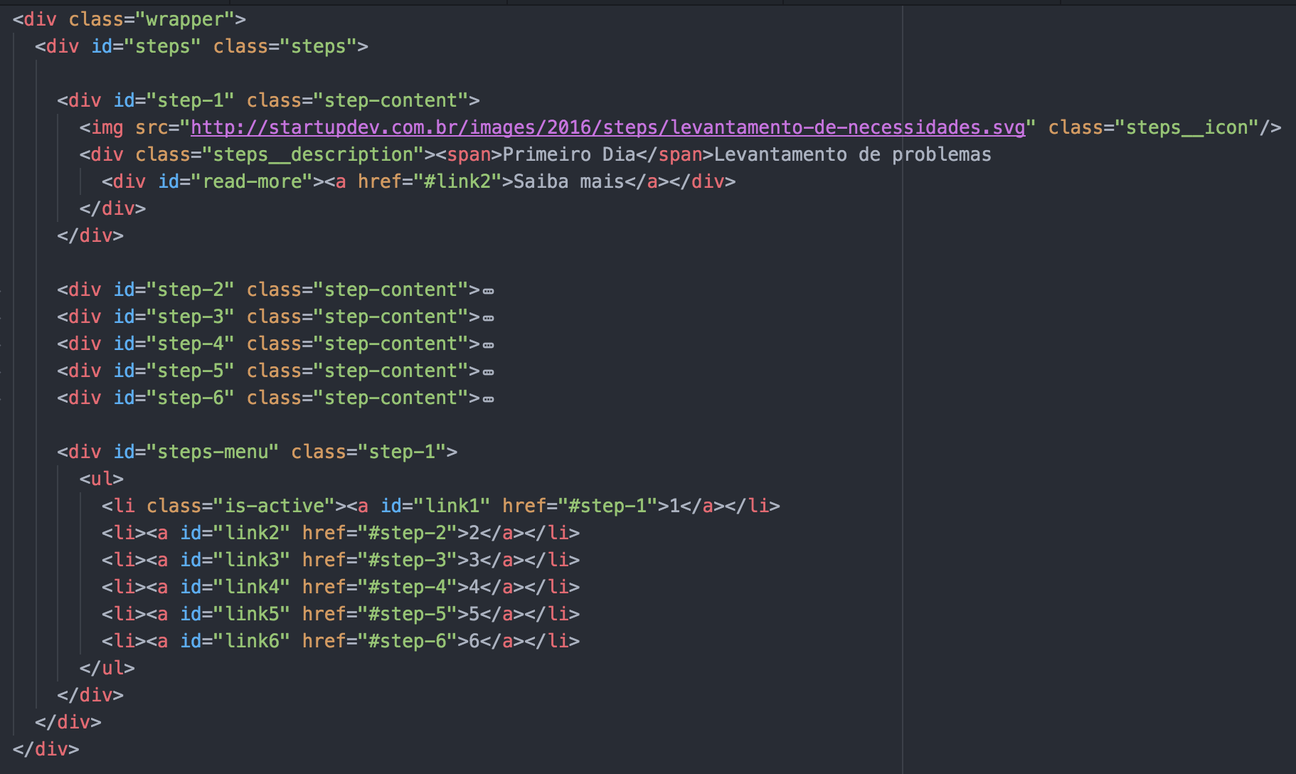
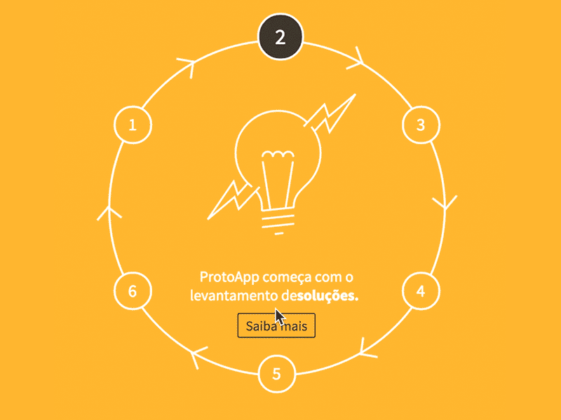
Interações com JS - html
CRIANDO INTERFACES INTERATIVAS COM SVG + SASS + JAVASCRIPT

Slide 22
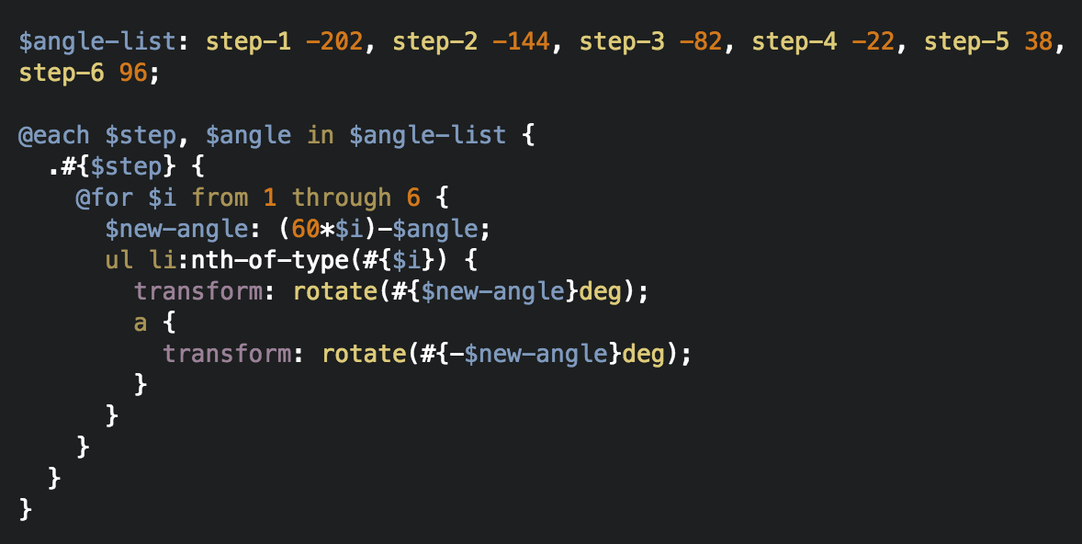
Interações com JS - scss
CRIANDO INTERFACES INTERATIVAS COM SVG + SASS + JAVASCRIPT

Slide 23
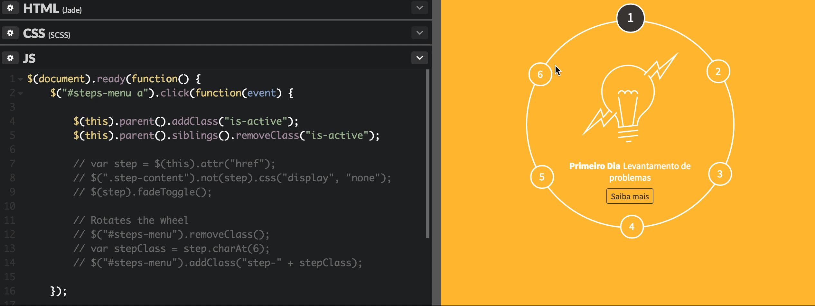
Interações com JS - js
CRIANDO INTERFACES INTERATIVAS COM SVG + SASS + JAVASCRIPT

Slide 24
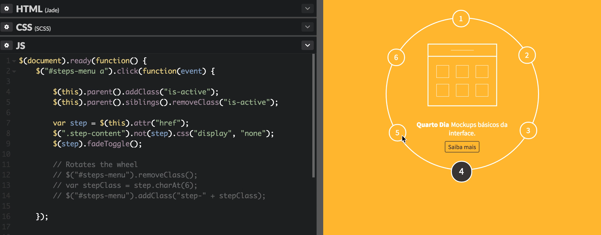
Interações com JS - js
CRIANDO INTERFACES INTERATIVAS COM SVG + SASS + JAVASCRIPT

Slide 25
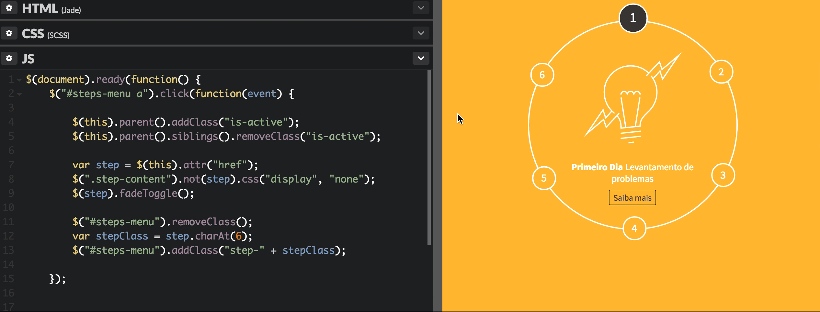
Interações com JS - js
CRIANDO INTERFACES INTERATIVAS COM SVG + SASS + JAVASCRIPT

Slide 26

CRIANDO INTERFACES INTERATIVAS COM SVG + SASS + JAVASCRIPT
Krystal Campioni
@krystalcampioni

